Slide 1



Introduction to ORCAD
(EBN 111 : Electricity and Electronics)
Pre-Practicum 1
By D.A. Barnard

Slide 2

EBN 111: Practical 1
Objectives
Familiarize students with OrCAD
Execute circuit simulation in OrCAD
Complete Practical Assessment
  Practical 1 will take place during the week of
  28 February - 4 March
  Group allocations will be posted on the website

Slide 3

EBN 111: Practical 1
OrCAD
Schematic Capture and circuit Simulation are two essential tools in computer aided circuit analysis and design
Computer aided design makes it possible to deal with problems which are computationally very complex and lengthy without the aid of a computer
Simulation software is part of modern engineering practice
This practical provides an opportunity to gain some skills in using these tools, which are used in many subsequent modules

Slide 4

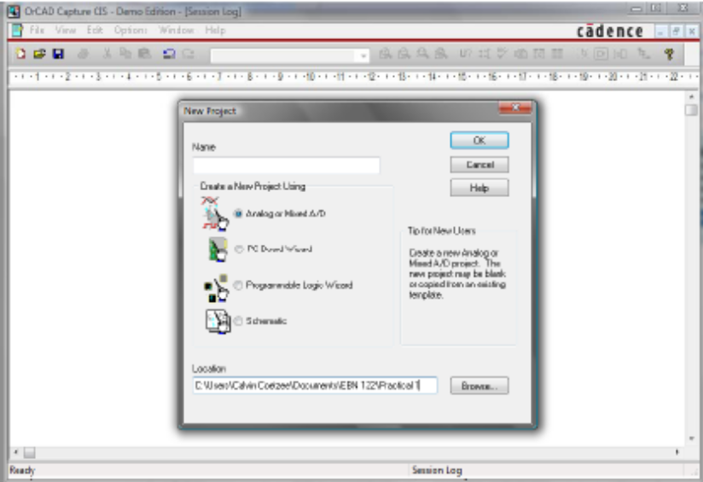
EBN 111: Practical 1
OrCAD
What is Schematic Capture?
Schematic Capture is an electronic means of graphically constructing a circuit in a format that can be subsequently read by software such as PSpice for circuit simulation and by OrCAD Layout for circuit board layout

Slide 5

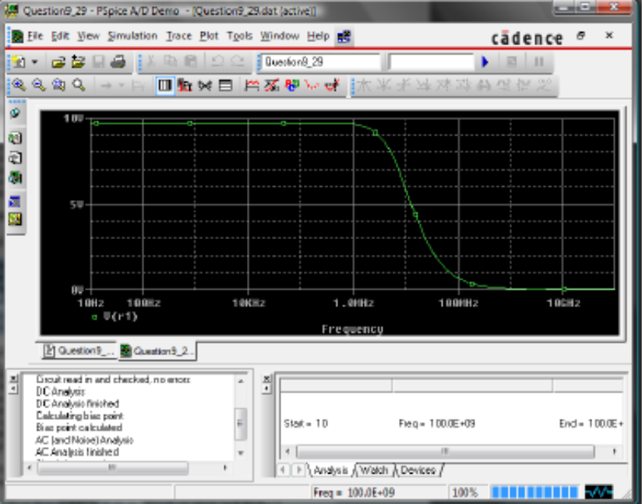
EBN 111: Practical 1
OrCAD
What is SPICE and what is PSpice?
SPICE was originally an analogue circuit simulator software package that was developed at the University of California at Berkeley
PSpice is a version of SPICE for personal computers

Slide 6

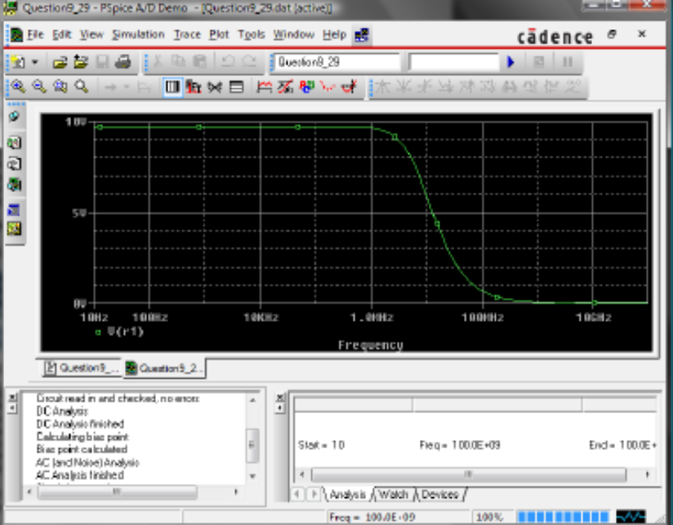
EBN 111: Practical 1
OrCAD
How does PSpice help in circuit analysis and design?
PSpice’s strong point is that it helps the user simulate and analyse the circuit design graphically on the computer without having to build a physical circuit

Slide 7

EBN 111: Practical 1
Preparation
Read through the PSpice Appendix D at the back of your prescribed textbook
Otherwise, search for an OrCAD PSpice Tutorial on the web
Example of a good tutorial:
  www.onlinefreeebooks.net/engineering-ebooks/electrical-engineering/pspice-tutorial-for-the-orcad-pspice-release-9-1-student-version-pdf.html
Complete the prescribed pre-practical assignment before the practical

Slide 8
EBN 111: Practical 1
Practicum requirements
What is required in order to complete the practical?
  Understand how to be able to create circuit schematics in OrCAD Capture
  Understand and complete bias point/time domain simulations
  Understand and complete DC sweep simulations
  Complete the pre-practical assessment questions

Slide 9
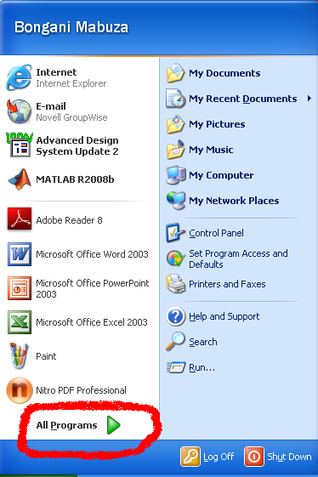
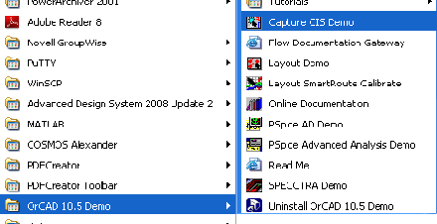
EBN 111: Practical 1
Launching Orcad
Open start menu
Go to Programs
Launch the OrCAD Capture CIS program

Slide 10
EBN 111: Practical 1
OrCAD – Creating a new project
How to create a new project?
  Choose “new project” from the file menu of OrCAD Capture
  Make sure the project is using Mixed analogue and AD, otherwise your project will not simulate
  Name the project as follows: S-studentno-PRAC1, e.g. S24242424PRAC1
  Choose as the “location” for your project the drive “D” and the directory “EBN111Results”. If the directory doesn’t exist, create it

Slide 11
EBN 111: Practical 1
Demonstration of different simulations
You can download a student version of the software from the EBN 111 website for working at home
Here is the link for the OrCAD software:
(ftp://ftp.ee.up.ac.za/pub/windows/eda/OrCAD_Demo_160.zip)
The OrCAD software is available in any of the engineering laboratories

Slide 12
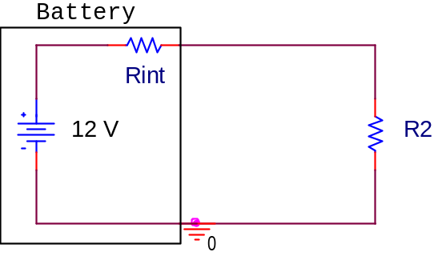
EBN 111: Practical 1
Pre-Practicum Questions
Consider the figure below
  The battery has internal resistance of 5Ω
  R2 is the load resistance
  R2 must be varied sequentially from 10 – 50Ω
Notes:
Important: load resistance. Battery has to drive a specific load. The resistor of interest. The internal resistor does not fall away.

Slide 13
EBN 111: Practical 1
Pre-Practicum Questions
Complete a simulation of the circuit for R2 = 5Ω
  Determine the current through R2
  Determine the voltage across R2
Sequentially set the value of R2 to five values in the range 10 - 50Ω
  Determine the load voltage (V2) across R2 and the current for each resistor value
Sweep the battery potential from 1 to 12 V in 1 V increments
  Determine the current through R2 for every increment

Slide 14
EBN 111: Practical 1
Pre-Practical Assignment
You will complete the pre-practicum assignment before you commence with your practical
  The assignment can be downloaded in pdf format from the EBN 111 website
  The pre-practical assignment is to be completed individually and submitted during tutorial class official
  Submission date: 25 February 2011

Slide 15
EBN 111: Practical 1
Pre-Practicum Questions
Plagiarism warning !!!
  Any copy of the same document for different students will be investigated immediately

Slide 16
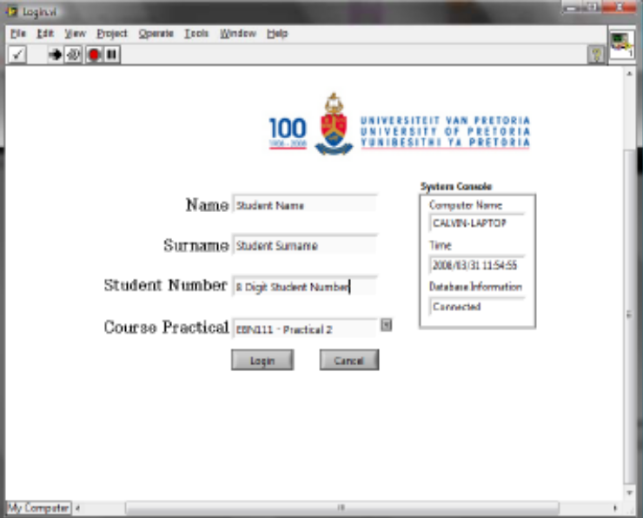
EBN 111: Practical 1
Practical Assessment - Online
The practical assessment will be carried out by completing an online assessment form
To launch the online assessment form, follow the instructions given during class
Online practical assessment
  Launch the program
  Fill in your details: Name, Surname, Student no.
  Select the practical
  Login

Slide 17
EBN 111: Practical 1
Practical Assessment - Online
Once you have completed the entire practical, submit the practical
  Your mark will be shown to you and emailed to your student account
Practical assessment breakdown
  Pre-Practical Test: 50 %
  Practical: 50 %

Slide 18
EBN 111: Practical 1
Conclusion - Enjoy
Contact details for Questions or Feedback
  Email: dieter.barnard@up.ac.za
    NB: For all emails use the subject “[EBN 111] …”
  Office no.: Eng 1, 14-5
  Tell no.: 012 420 2060 (only when necessary, only!)
During practical
  There will be demis to assist you during the whole duration of the practical
  Ask questions and remember you can also refer to the practical guide or materials available on the module website
Notes:
Please make sure that you can do most of what is given in the slides!
I can help with theory, but PSPice you will have to learn on your own.
Try and get a friend from second or third year to help you. They should know how to use the software.

